Slide 1
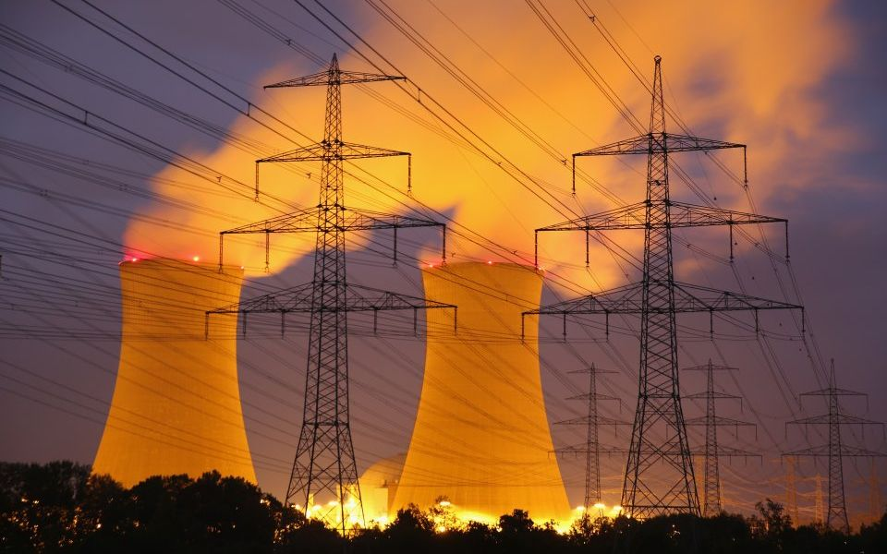
Integrating Nuclear and Renewable Energy Sources
Joseph Lee Adria Peterkin Pedro Vicente

Slide 2
This Presentation will Focus on
The Energy Dilemma
Characterizing the Technology
Phase 1
Phase 3
Phase 2
Phase 4
The Technology
Important Considerations

Slide 3
Phase 1:
The Energy Dilemma

Slide 4
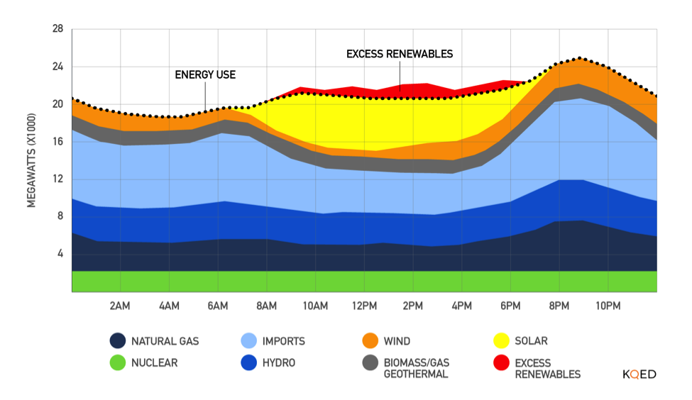
Introduction
Notes:
With greater renewable energy production in the recent years, electricity supply into the grid has become more unpredictable. This of course is because we don’t control the blowing of the wind nor the shining of the sun. This lack of predictability can lead to a supply of electricity greater than the demand as shown here which negatively affects the price of electricity. In order to add stability to the grid, we are proposing a method to allow nuclear power plants (or base load operating plants in general) to alter its electricity output (or load follow) to a given demand.

Slide 5
Phase 2:
The Technology

Slide 6
The Nuclear-Hydrogen Hybrid System
Electricity Production
Thermal Energy
Hydrogen Production
Notes:
The idea of how this works is very simple. We have a set amount of thermal energy available and we can allot this thermal energy to electricity production or hydrogen production depending on the electricity demand. So we can split this thermal energy is as such in times of of high electricity demand, moderate demand, and low demand.

Slide 7
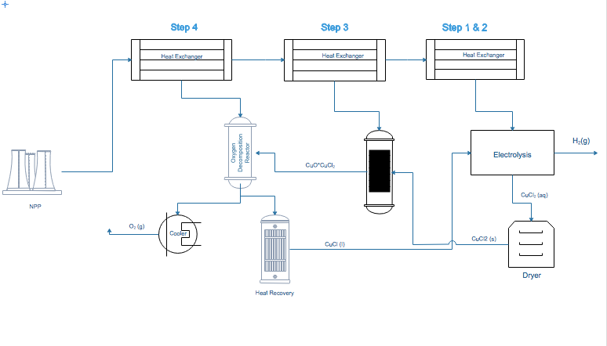
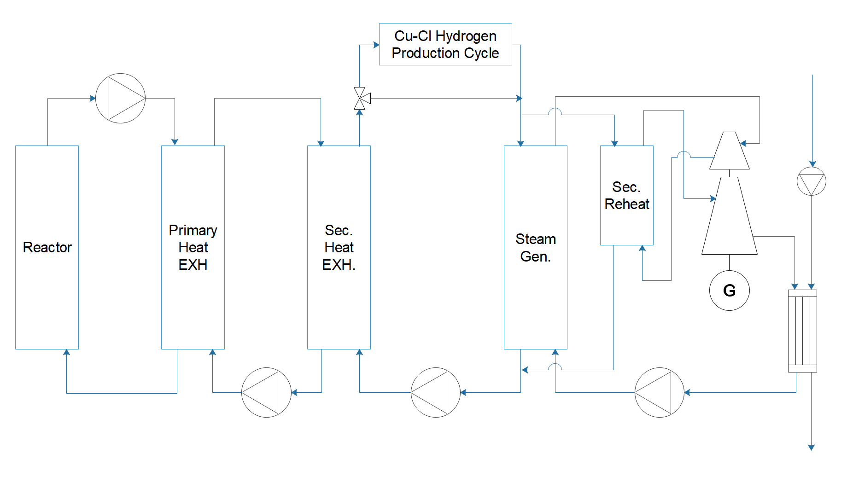
Our Design - Integration of a Molten Salt Reactor and a Cu-Cl Cycle Hydrogen Production

Slide 8

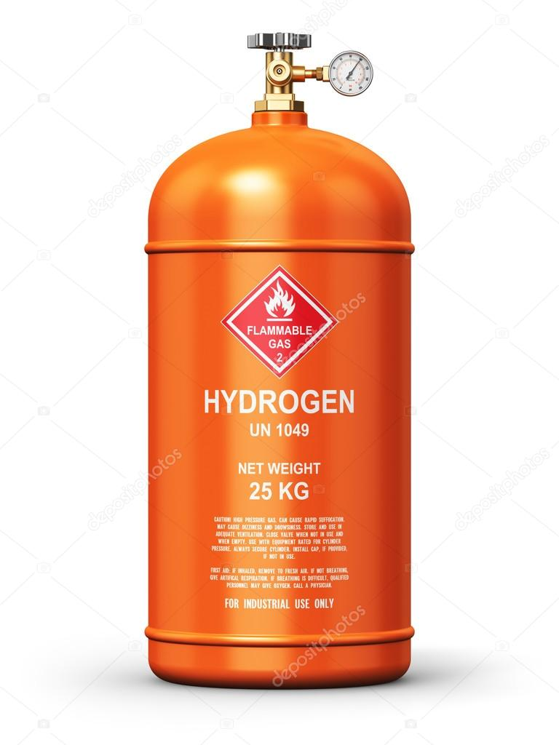



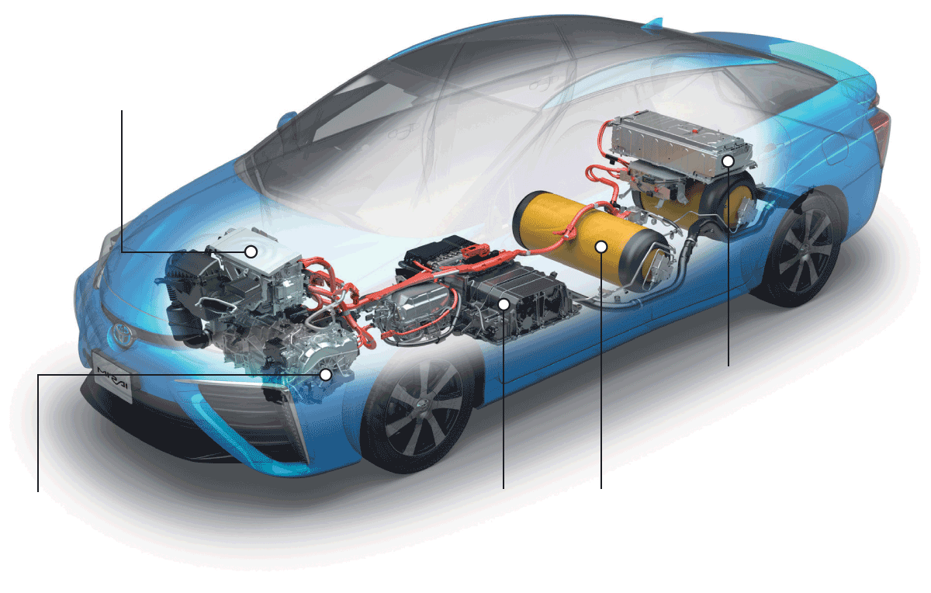
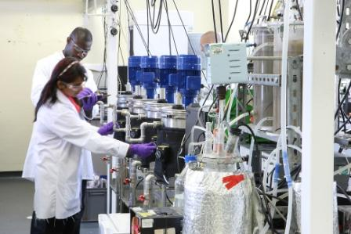
Who Benefits from a Hybrid System
Hybrid Energy System
Utility Companies
Hydrogen Industry
Commercial
Government/Corporations
Industry and Manufacturers
Research and Development
Notes:
Who benefits from the integration

Slide 9
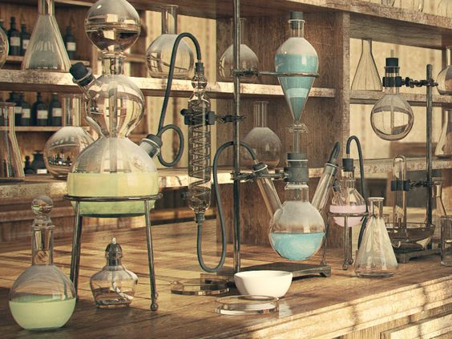
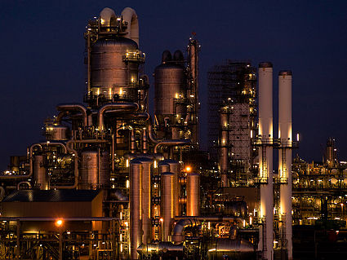
From Technology to Commercialization
Notes:
Scaling up

Slide 10
Phase 3:
Characterizing the Technology

Slide 11

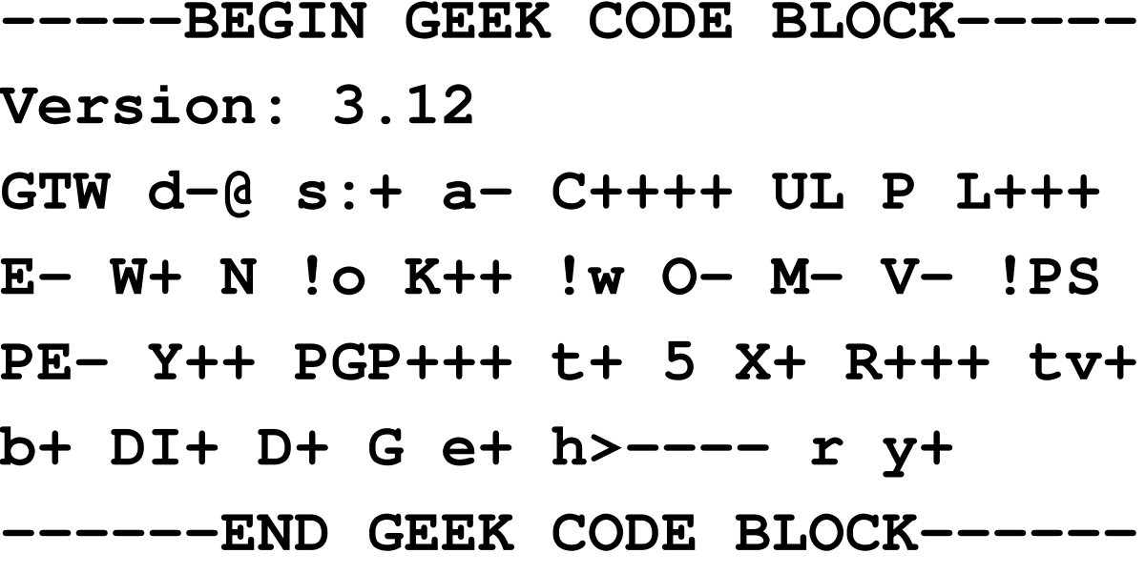
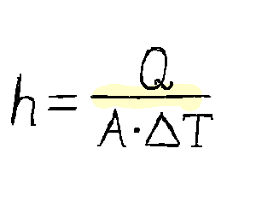
Characterizing Technical Components
Notes:
Where we got equations, expressions, and concepts

Slide 12
Methods: Code
Input
Code
Output
Energy Production
Electricity Demand
Hydrogen Production
Notes:
Of course while this idea is simple, characterizing our system is a bit more difficult. Complications arise because the relationship between electricity generation and heat input is not linearly correlated. Thus, without getting too bogged down by the technical details, what our code does is iteratively solve for the system characteristics (temperature, mass flow rate, and so on) that gives us the electricity output that we want. This code modifies these system characteristics until a system of equations derived from thermodynamic laws and characteristics of the heat exchanger that we chose are in agreement.
Of course while the idea is simple, characterizing our system is a bit more difficult. How our system will work is that we will put in an electricity demand which determines how the heat is split between electricity and hydrogen production. An issue arises when we change the heat going into these systems and to better explain that, I will focus on the electricity production side.
Electricity generation performs optimally at a certain temperature and if we decrease the amount of heat going into that system, we must also decrease the mass flow rate of the water in our electricity generation cycle such that this optimal temperature is reached. Thus ultimately, this code identifies iteratively solves for this mass flow rate along with other internal system characteristics and outputs the energy generation.

Slide 13
Phase 4:
Important Considerations

Slide 14
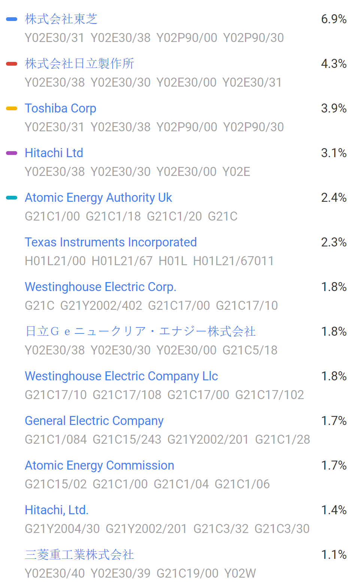



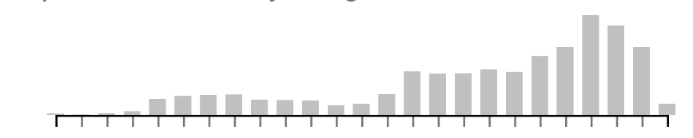


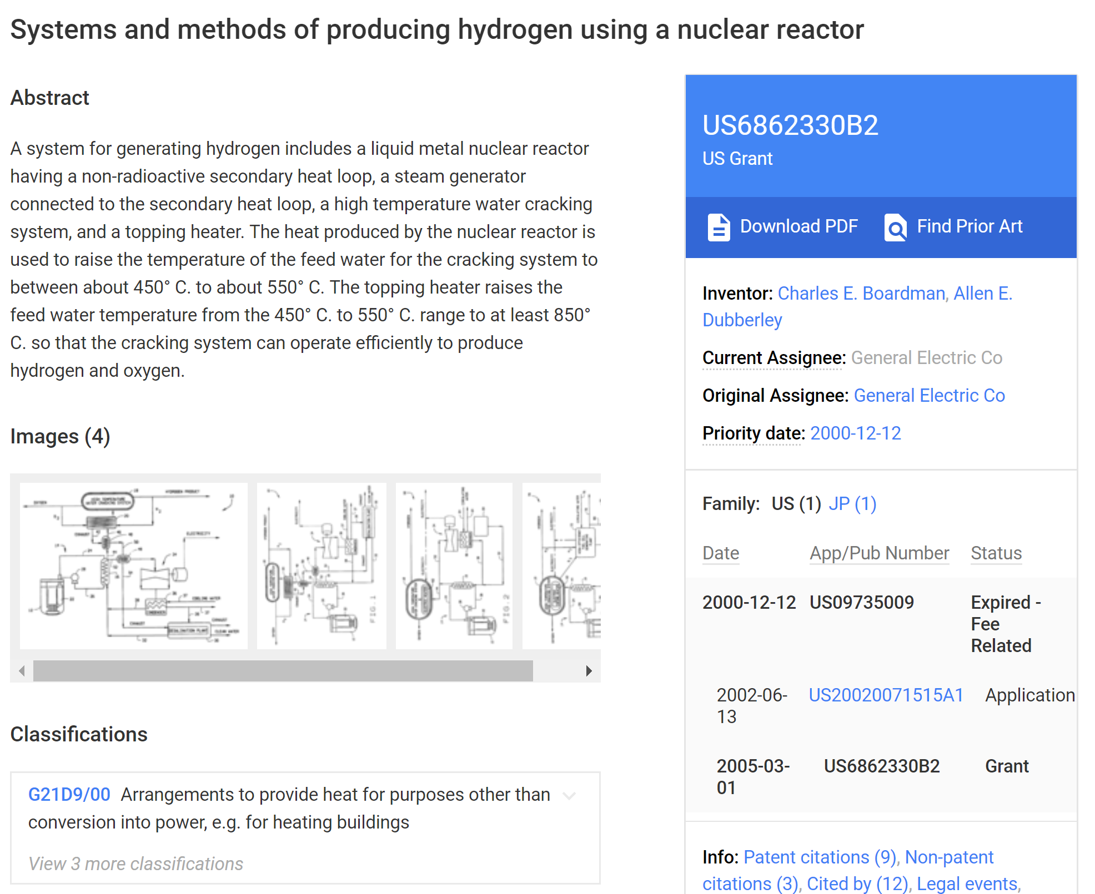


Protecting our findings (IP): Increasing attention from major industry players
1970 2019

Slide 15
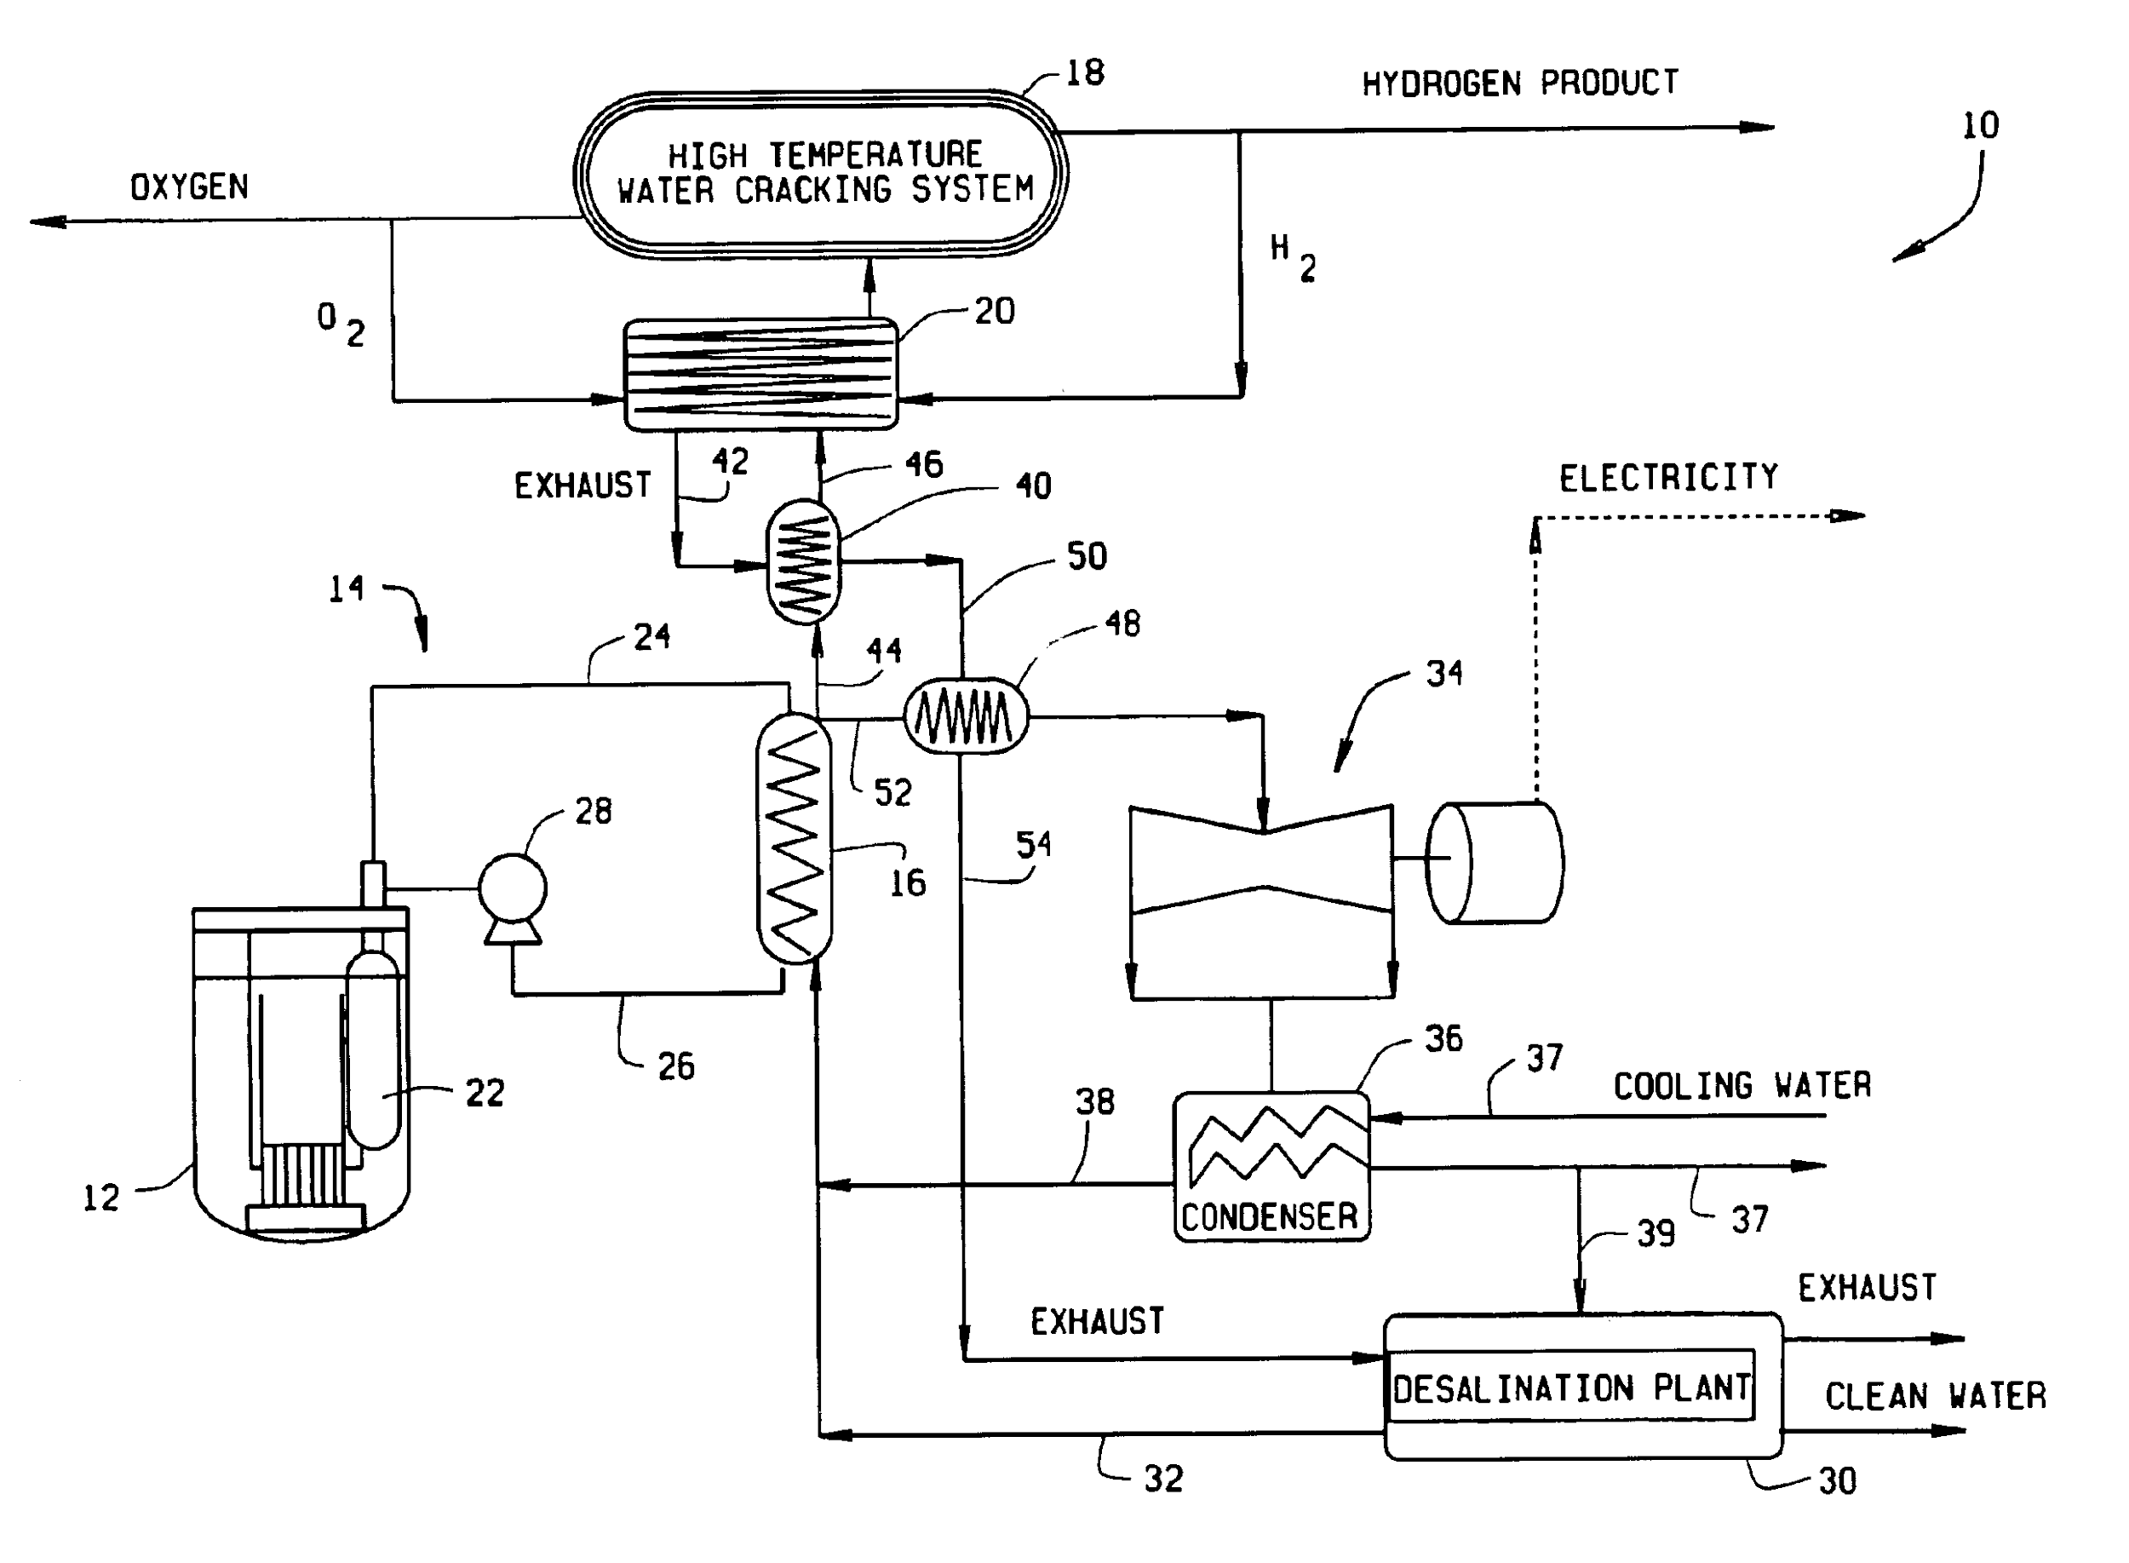
Example: General Electric
Industry Process (Hydrogen Production)
Electricity Production
Energy Source
(Nuclear Reactor)
Secondary Industry Process (Desalination Plant)

Slide 16
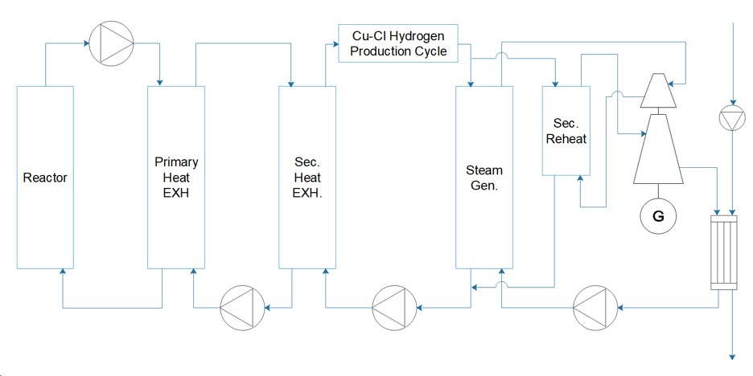
Our Design - Integration of a Molten Salt Reactor and a Cu-Cl Cycle Hydrogen Production

Slide 17
NSPE Code of Ethics and Unintended Consequences Management
Stage 1: Design and Virtual Simulation | Stage 2: Test | Stage 3: Build | Stage 4: Use
Failure to correctly design certain components of a complex system. | Prototype does not work as intended. | Theoretical designs and tests slightly different from reality causing redesign. | Hydrogen Production Malfunction
Goals not reachable due to shortness in team members, time and expertise. | Regulatory bodies request additional information causing unexpected delays. | Project acceptance problems by the local community of the selected location. | Radioactive Contamination of secondary loops.

Slide 18
Take Away Points
Nuclear Energy must be considered as a means of attaining sustainable energy
Hybrid Energy systems are pivotal aspects of Grid Stability
Hybrid Energy systems make nuclear power more economically feasible
There is an increase attention to these type of systems from major industry players.

